Slide 1
Tutorial 6
JOPtionpane, random number generation
CSCI1130

Slide 2
Content
JOptionPane
Introduction to Random Number
Applications of Random Number
Method of Generation
Math.random()
Class Random()
Random Seed
Exercise: Allow/ Avoid Duplication
Assignment 3

Slide 3
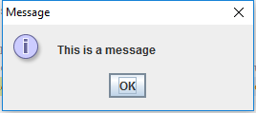
public static void showMessageDialog(Component parentComponent, Object message)
Tell the user about something that has happened.
JOptionPane.showMessageDialog(null,"This is a message");
JOptionPane.showMessageDialog()

Slide 4
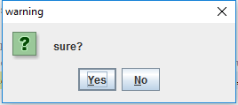
public static int showConfirmDialog(Component parentComponent, Object message, String title, int optionType)
Asks a confirming question, like yes/no/cancel.
The returned int indicates index of selected option. In this example, Yes: 0, No: 1, close dialog button: -1.
JOptionPane.showConfirmDialog(null,"sure?","warning",JOptionPane.YES_NO_OPTION);
JOptionPane.showConfirmDialog()

Slide 5
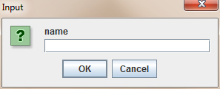
public static String showInputDialog(Object message)
Shows a question-message dialog requesting input from the user.
The return value is the string input by user.
If Cancel or close dialog button is clicked, return null.
String username = JOptionPane.showInputDialog("name");
JOptionPane.showInputDialog()

Slide 6
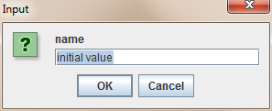
public static String showInputDialog(Object message,Object initialSelectionValue)
Shows a question-message dialog requesting input from the user, with the input value initialized to initialSelectionValue.
The return value is the string input by user.
JOptionPane.showInputDialog("name", "initial value");
JOptionPane.showInputDialog()

Slide 7
Introduction to Random Number
Definition^{[1]}
Random Number: Numbers that cannot be reasonably predicted better than by a random chance.
Pseudo-random Number: Numbers that look random, but are actually deterministic, and can be reproduced if the state of the PRNG is known
[1] https://en.wikipedia.org/wiki/Random_number_generation
Notes:
PRNG is a Pseudo-random Number generator, it uses mathematical algorithm to generate random number. On the other hand, TRNG is generator for true random number, it uses an unpredictable physical means like atmospheric noise to generate random number.

Slide 8
Applications of Random Number
Divination
Games
Political use
Athenian democracy
Modern use
Science
Statistical sampling
Analysis
Simulation
Literature, music and art
…
[2] https://en.wikipedia.org/wiki/Applications_of_randomness
Notes:
Random number generators have applications in statistical sampling, computer simulation and other areas where producing an unpredictable result is desirable.

Slide 9
(Pseudo) Random Number Generation
Methods:
Math.random()
Using class Random
Notes:
Since true random number is difficult to obtain, we mainly use (Pseudo) Random Number. There are two ways to generate (Pseudo) Random Number in java.

Slide 10
Math.random()
Input Arguments
None
Return
A random number in a uniform distribution
Data type: double
Range: [0.0, 1.0) ; Excluding 1.0
Can be considered as a probability value
To generate a random number within [m, n)
Apply a scaling factor of (n-m) with an offset value m
double m = -2.6, n = +8.3;
double value = Math.random() * (n-m) + m;
Notes:
Math.random() generates a random number between 0 and 1. the type of return value is double.

Slide 11
Class Random()
import java.util.Random;
An instance of this class can be used for generating a stream of pseudo-random numbers.
Constructor Random( )
For creating a new random number generator object with auto-seeding.
Overloaded Constructor Random( long seed )
For creating a new random number generator object with a long integer-type parameter seed.

Slide 12
Methods
Random rngObj = new Random(20161001);
result = rngObj.nextInt();
Get the next pseudorandom, uniformly distributed int value from this random number generator object's sequence
result = rngObj.nextInt(10);
Get the next pseudorandom, uniformly distributed int value within 0 to 9 (note that 10 is excluded.)

Slide 13
Methods
Random rngObj = new Random(20161001);
result = rngObj.nextDouble();
Get the next pseudorandom, uniformly distributed double value between 0.0 (inclusive) and 1.0 (exclusive)
result = rngObj.nextGaussian();
Returns the next pseudorandom, Gaussian ("normally") distributed double value with mean 0.0 and standard deviation 1.0.

Slide 14
Output Range Control
nextInt() returns an int in [-2³¹, +2³¹)
nextInt( int bound ) returns an int in [0, bound-1]
excluding the upper bound value
e.g.
[a, b] rngObj.nextInt( b - a + 1) + a;
(a, b] rngObj.nextInt( b - a ) + a + 1;
[a, b) rngObj.nextInt( b - a ) + a;
(a, b) rngObj.nextInt( b - a - 1 ) + a + 1 ;

Slide 15
Random Seed
A random seed is a number used for initializing a pseudo-random number generator. The seed governs the behavior of the PRNG*.
PRNG objects created with the same random seed will produce identical pseudo-random number sequences.
* PRNG: Pseudo-Random Number Generation

Slide 16
Random Seed (Example)
import java.util.Random;
...
int seed = 11;
Random rngObj1 = new Random(seed);
Random rngObj2 = new Random(seed);
Random rngObj3 = new Random( );
System.out.printf("%12d\n", rngObj1.nextInt() );
System.out.printf("%.2f\n", rngObj1.nextFloat() );
System.out.printf("%12d\n", rngObj2.nextInt() );
System.out.printf("%.2f\n", rngObj2.nextFloat() );
System.out.printf("%12d\n", rngObj3.nextInt() );
System.out.printf("%.2f\n", rngObj3.nextFloat() );
-1158177819
0.71
-1158177819
0.71
1856327341
0.34

Slide 17
Output Range Control (Examples)
[-10, 15]
rngObj.nextInt(26) - 10;
(-10, 15]
rngObj.nextInt(25) - 9;
[10, 15)
rngObj.nextInt(5) + 10;
(10, 15)
rngObj.nextInt(4) + 11;

Slide 18
Exercise: Allow/ Avoid Duplication
How to allow or avoid duplications between 3 random numbers?
If we allow duplication,
Simply generate 3 random numbers independently
Example: 4,2,4
If we need avoid duplication,
Perform comparisons; reject ties and re-generate
Example: 4,2,6

Slide 19
Exercise: Avoid Duplication
Draft your solution.
Communicate your idea with peers.
Share with the class.

Slide 20
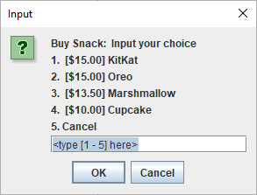
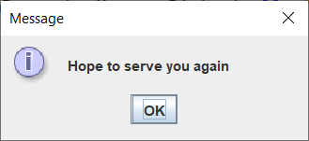
Assignment 3: Snack Time
Main task
Create a Java application for a vending machine
It allows user to buy snack
When user click/input cancel, show ending message and exit
main interface
5

Slide 21
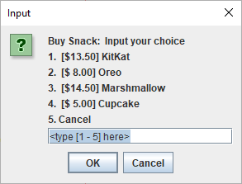
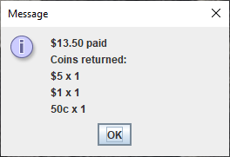
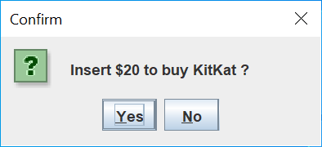
Assignment 3: Snack Time
Buy snack
Generate random price for each kind of snack when program starts
Request user input to select which snack to buy
Ask user whether to insert a $20 banknote
Show change in coins ($10, $5, $2, $1, 50c)
1

Slide 22
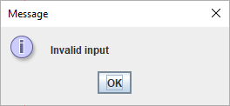
Handing invalid inputs
Pop up a warning dialog “Invalid input” for receiving an invalid choice or out-of-range number from user; then return to the main interface.
Assignment 3: Snack Time

Slide 23
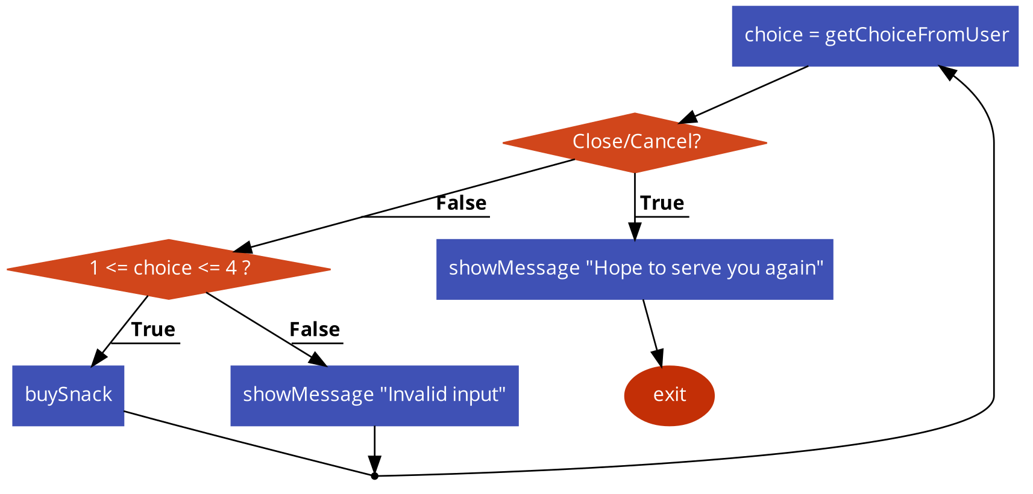
Assignment 3: Snack Time
Program flow
It’s recommended to draft the program flow to make the programming clear before you start coding.
Example (main interface):

Slide 24
Assignment 3: Snack Time
Use String.format to get the formatted string String.format(String format, Object ... args).
e.g.
String.format("%s spent %.2f dollars on books.", "Joe", 123.4567)
=>
Joe spent 123.46 dollars on books.

Slide 25
Use Integer.parseInt to convert a string that contains an interger to an int variable Integer.parseInt(String s). e.g. int a = Integer.parseInt("123"); => a=123
How to deal with strings not containing an integer? Answer: use exception handling
int i; String s = "not an integer"; try {
i = Integer.parseInt(s);
} catch (NumberFormatException e) {
i = -100; // -100 should not be in the valid range
}
Assignment 3: Snack Time

Slide 26

Appendix: Application1 Mark Six
How to generate 6 unique random numbers in the range of [1 – 49]?

Slide 27
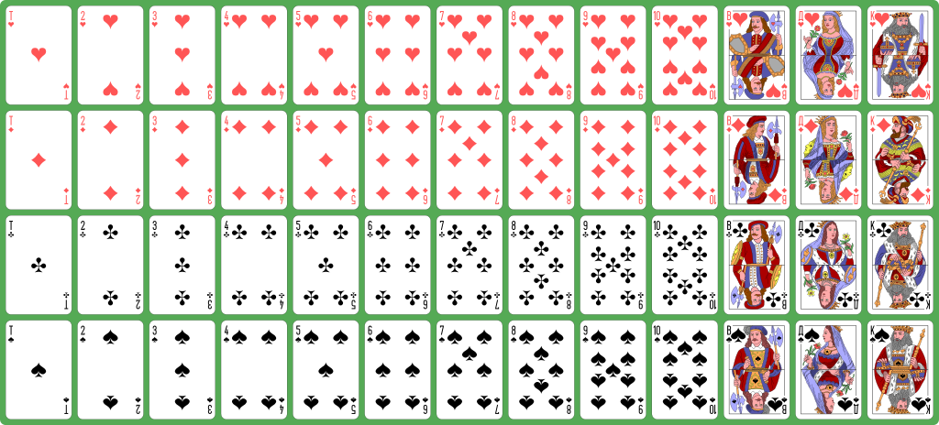
Appendix: Application2 Shuffling
How to shuffle a deck of playing cards randomly?
Source: https://commons.wikimedia.org/wiki/File:Atlasnye_playing_cards_deck.svg
Notes:
Randomize Index

Slide 28
Further Reading
Ziggurat algorithm
https://en.wikipedia.org/wiki/Ziggurat_algorithm
Box–Muller transform
https://en.wikipedia.org/wiki/Box–Muller_transform

Slide 29
END

